Slide 1
SOLO Taxonomy
Structure of the Observed Learning Outcome
SOLO taxonomy is chosen because it, with the associated verb, logically describes the progression that is “subject pillars” of the individual programs.
SOLO taxonomy can be used to classify the depth of learning and understanding.
Notes:
Forklar de forskellige nivauer
Hvilke nivauer man har, hvornår og på hvilket semester

Slide 2
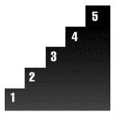
SOLO taxonomy is a model that describes levels of increasing complexity in student's understanding of subjects.
SOLO 5
○ to generalize
○ to hypothesize
○ to theorize
○ ...
"extended abstract"
deep
(qualitative
levels)
SOLO 4
○ to relate
○ to compare
○ to analyze
○ ...
"relational"
SOLO 3
○ to classify
○ to combine
○ to enumerate
○ ...
"multi-structural"
surface
(quantitative
levels)
SOLO 2
○ to identify
○ to do procedure
○ to recite
○ ...
"uni-structural"
SOLO 1
○ no understanding
○ irrelevant information
○ misses point
○ ...
"pre-structural"

Slide 3
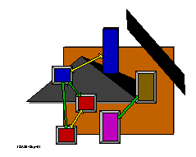
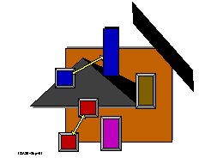
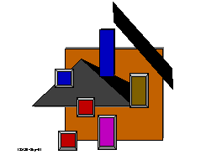
SOLO
SOLO 5
○ to generalize
○ to hypothesize
○ to theorize
○ ...
"extended abstract"
SOLO 4
○ to relate
○ to compare
○ to analyze
○ ...
"relational"
SOLO 3
○ to classify
○ to combine
○ to enumerate
○ ...
"multi-structural"
SOLO 2
○ to identify
○ to do procedure
○ to recite
○ ...
"uni-structural"
SOLO 1
○ no understanding
○ irrelevant information
○ misses point
○ ...
"pre-structural"

Slide 4
SOLO (more verbs)
SOLO 5
to theorize
to hypothesize
to generalize
to critesize theory
provide perspective
to apply theory on new relationships
to predict
to reflect on theory of recognition
to review
to discuss
"extended abstract"
SOLO 4
to analyze
be argumentative
to relate
to compare
to incorporate
to apply theory on known relationship
to reason reach conclusion
to explain
"relational"
SOLO 2+3
to structure
to summarize
to combine
to classify
to describe
to do a procedure
to paraphrase
to refer
to enumerate
to name
to identify
to recite
"multi structural"
&
"uni structural"

Slide 5
Constructive alignment
Alignment – what is that? - film
Teachers intention
Student activity
Teachers intention
Student activity
Unaligned
Aligned
Exam
Assessment
Exam
Assessment

Slide 6
Examples of ”Deep and Surface approach”
Deep | Surface
Focus is on “what is signified” | Focus is on the “signs” (or on the learning as a signifier of something else)
Relates previous knowledge to new knowledge | Focus on unrelated parts of the task
Relates knowledge from different courses | Information for assessment is simply memorized
Relates theoretical ideas to everyday experience | Facts and concepts are associated unreflectively
Relates and distinguishes evidence and argument | Principles are not distinguished from examples
Organises and structures content into coherent whole | Task is treated as an external imposition
Emphasis is internal, from within the student | Emphasis is external, from demands of assessment

Slide 7
Learning happens when …
When it is clear to the students what is expected, what the goal is, when they can see ”meaning” of going there
When the student feels a need to get there. Good teaching is to convey the need, where it is not clear or missing. Motivation is a product of good teaching and not a prerequisite.
When students feel comfortable in the relation to focus on the goal. If you try to generate pressure for them to learn using not well thought examination and assessment methods, it can have the opposite effect. Then it becomes a question of passing the test rather than about understanding.
Students work with others and interact with both fellow students and teachers. Good dialogue evokes the activities / processes that shape and develop deep learning

Slide 8
7-point grading scale
ECTS-scale
7-point - scale
12
For an excellent performance displaying a high level of command of all aspects of the relevant material, with no or only a few minor weaknesses.
A
10
For a very good performance displaying high level of command of most aspects of the relevant material, with only minor weaknesses.
B
7
For a good performance displaying good command of the relevant material, but also some weaknesses.
C
4
For a fair performance displaying some command of the relevant material, but also some major weaknesses.
D
02
For a performance meeting only the minimum requirements for acceptance.
E
00
For a performance which does not meet the minimum requirements for acceptance.
Fx
-3
For a performance which is unacceptable in all respects.
F

